Slide 1
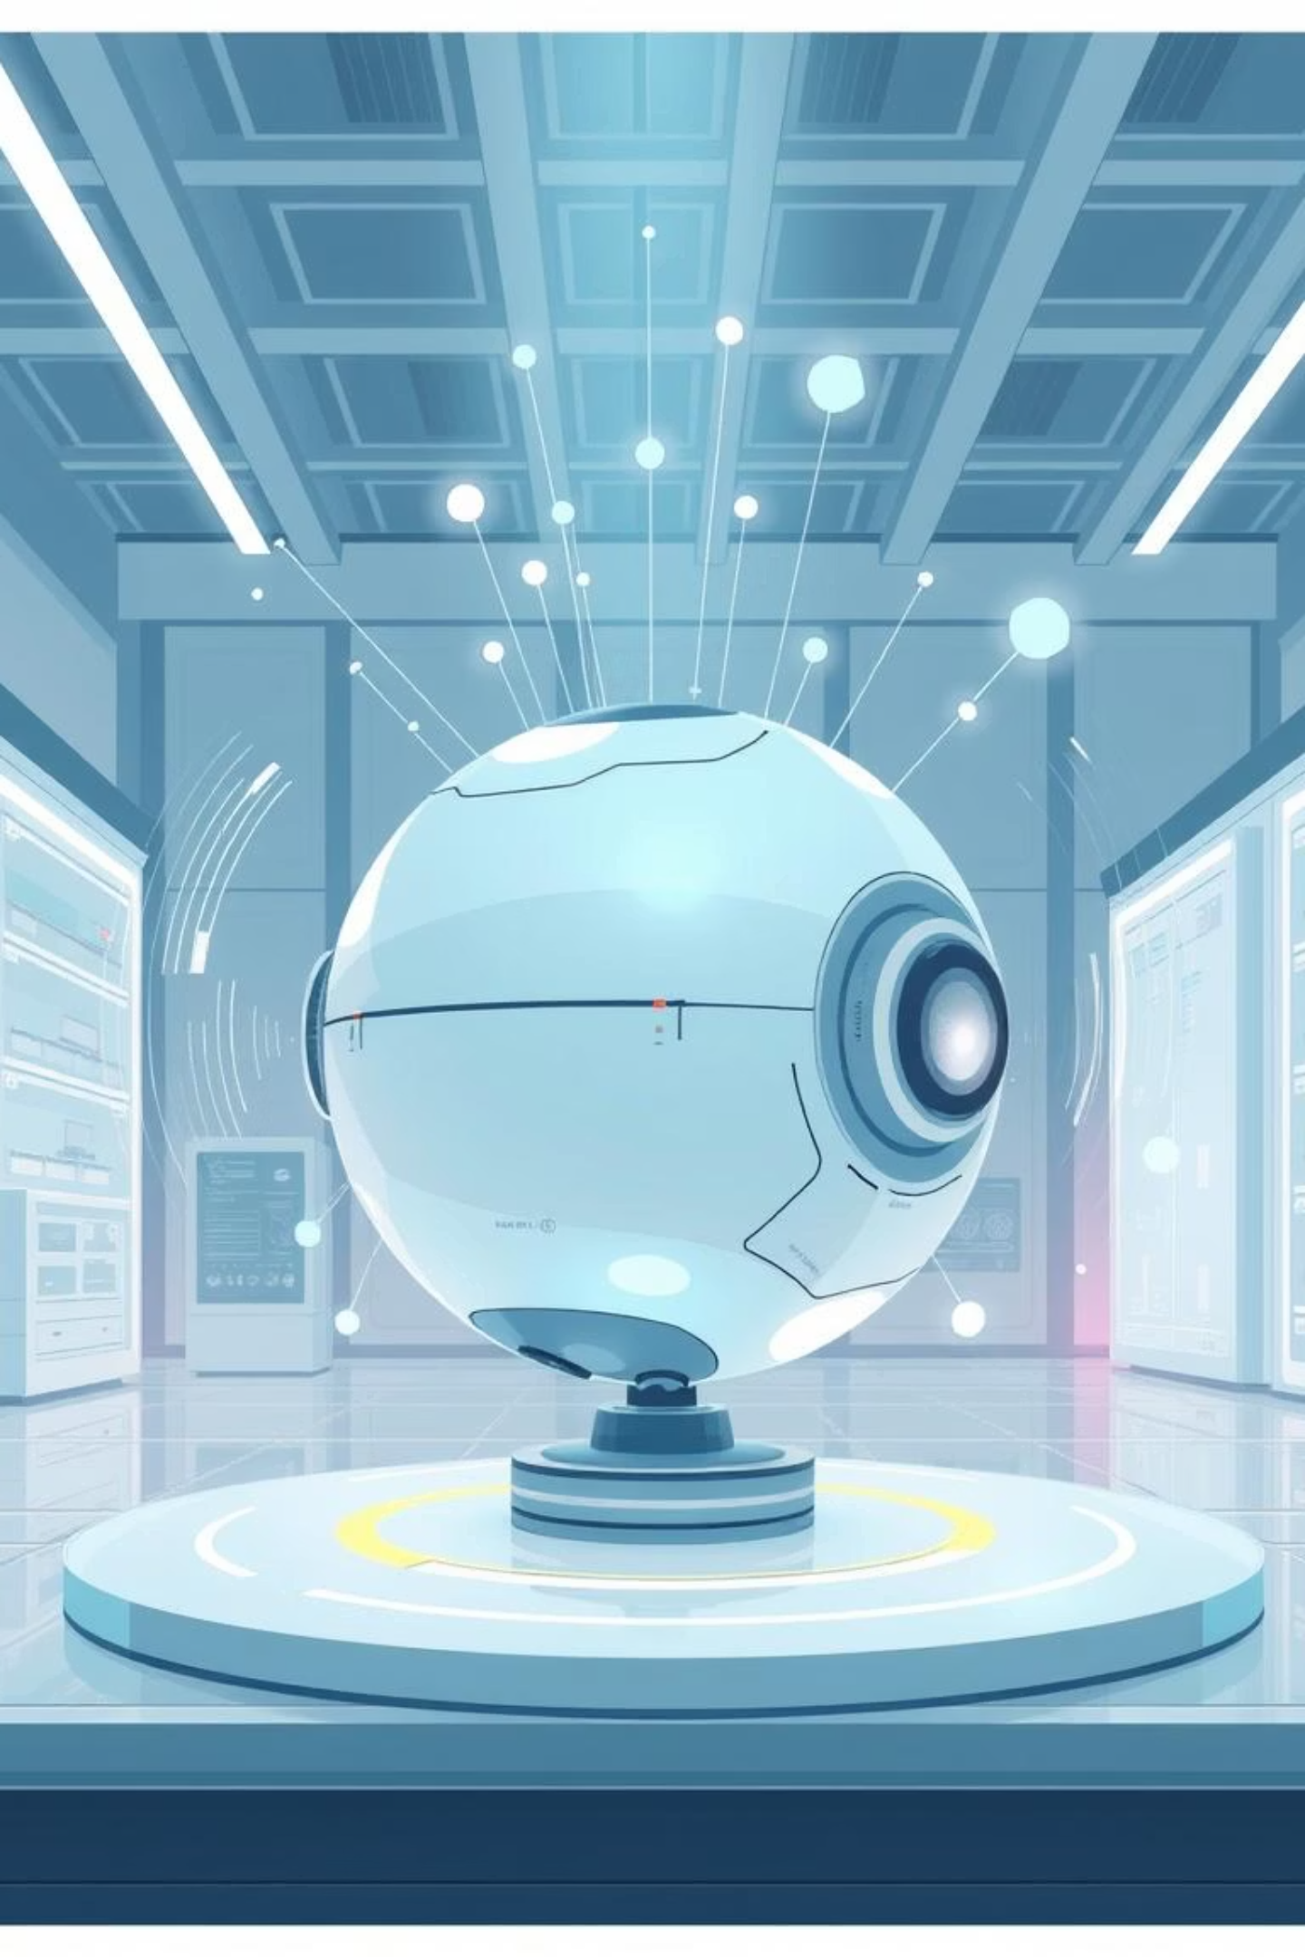
LESSON 4: ADVANCED EVENTS & INTERACTIVE SYSTEMS
Welcome to Lesson 4! Today, we're diving into the exciting world of event-driven programming.

Slide 2
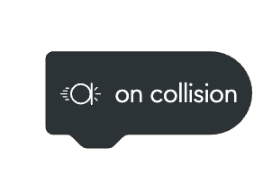
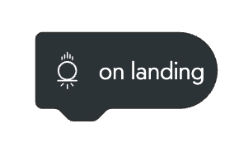
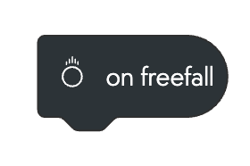
WHAT ARE ADVANCED EVENTS?
Beyond the "Start Program" Button
You already know that events trigger programs. So far, you've mainly used "When Start Program." But what happens when your Sphero interacts with its environment?
When Collision
When Landing
When Free Fall
Your Sphero bumps into something.
Your Sphero stops falling (after a free fall).
Your Sphero is dropped or goes airborne.
Think about it: How does your phone know you're touching the screen? How do automatic doors open? It's all about events!

Slide 3


CORE ACTIVITY
Building Your Interactive System
Your challenge is to make Sphero respond distinctly to physical actions. This is your first step into truly interactive programming!
You will use:
Collision
Landing
Free Fall
For this activity, keep it simple:
One event = one simple response.
Requirements:
Program a response to Collision (LED + sound).
Program a response to Landing (LED + sound).
Program a response to Free Fall (LED + sound).
Each event must have a different LED color and unique sound to tell them apart!

Slide 4
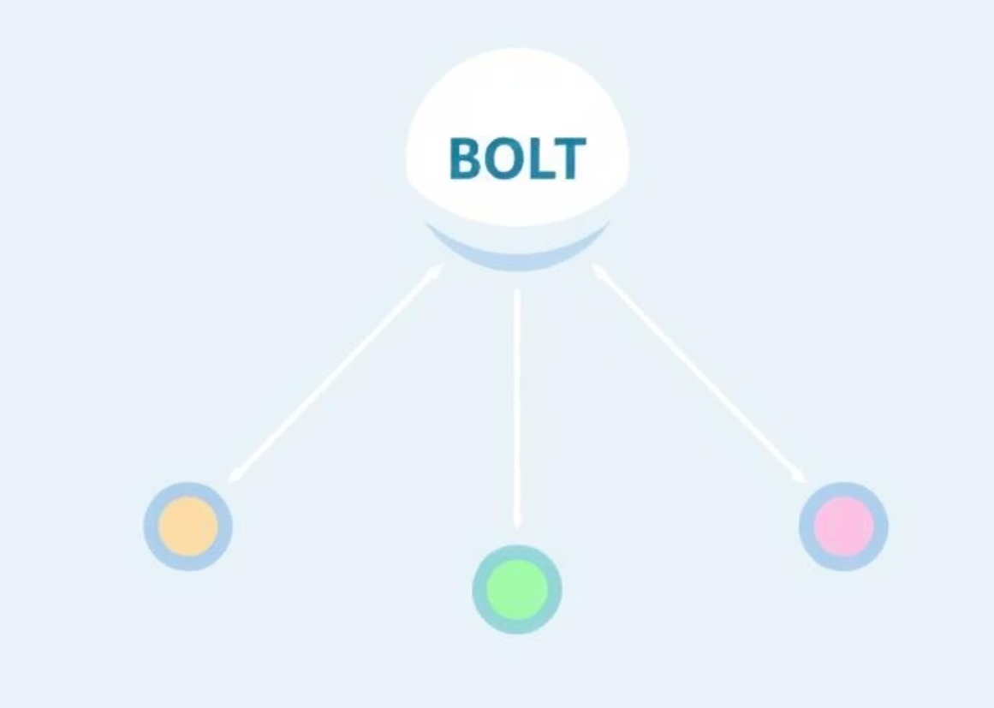
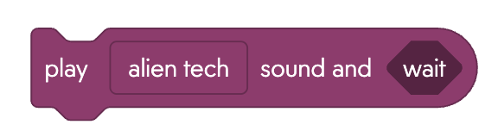
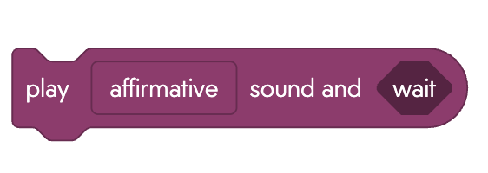
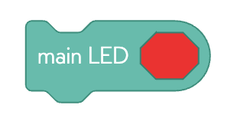
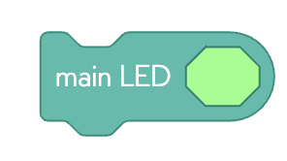
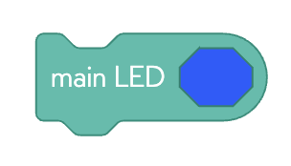
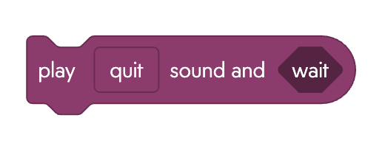
Core Activity
Event Explorer
This option focuses on the fundamental implementation of each event, ensuring you grasp the basic concept before moving to more complex ideas.
Example Implementation:
[On Collision] → Red LED + "crash" sound
[On Landing] → Green LED + "ding" sound
[On Free Fall] → Blue LED + "whoosh" sound
Success Criteria: All three events trigger clearly different and recognizable responses.
Time Estimate: 15-20 minutes | Difficulty: ⭐ (Basic event blocks only)

Slide 5
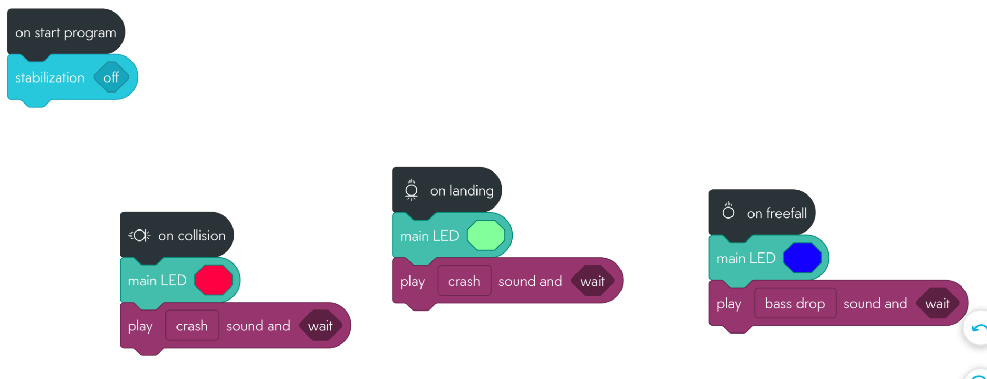
Solution
Notes:
Extension Idea - What happens if you add a matrix animation or speak block? pay attention to the play sound block - the wait will prevent the code from going to the next block. Children will have to click on the block to ‘continue’

Slide 6


MINI PLENARY
Check Your Understanding
Let's pause and see what you've learned. Discuss these questions with your group:
What's the key difference between a "start program" event and a "collision" event?
If you drop Sphero, which event fires first: Free Fall or Landing? Why?
How is what you're doing similar to how a smartphone responds when you touch its screen?
Can you think of other real-world events that might be useful for interactive programs?
Success Check
Safe Testing
Event-Driven
All three events trigger appropriate responses.
You can safely test each event type.
You understand programs can "wait" for events.
Notes:
Some times Freefall will appear not to execute if the distance is too short - try adding delay or make sure that the sound played goes first and uses continue before a color block, length of sound chosen could also effect if sound gets played.

Slide 7
Challenge
Smart Sensor System
Core Challenge: Combine events with sensor-based IF conditions Programming Focus: Event triggers + sensor readings + conditional responses
Requirements:
Use accelerometer readings within event responses
Add light sensor conditions to modify behavior
Create "smart" responses that change based on environment
Bonus : Could you include the on freefall in your system?
Notes:
Teacher Note: This challenge builds on the previous if/else lesson. Students will need to combine multiple sensors and events together, so remind them to use "if/else" statements when checking related conditions (like high vs. low accelerometer readings) to avoid conflicts. Encourage them to think about how their device should behave differently in various situations - for example, a hard landing might need different responses in bright light versus darkness. The bonus "on freefall" event adds an extra layer of complexity where students can create responses for when the device is falling through the air before it lands.

Slide 8
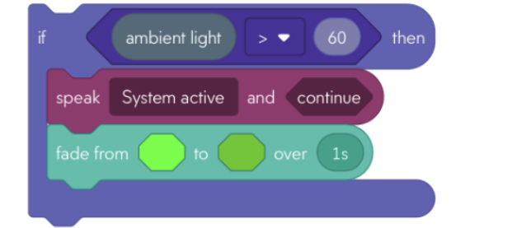
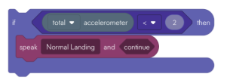
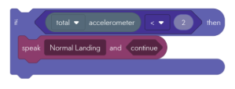
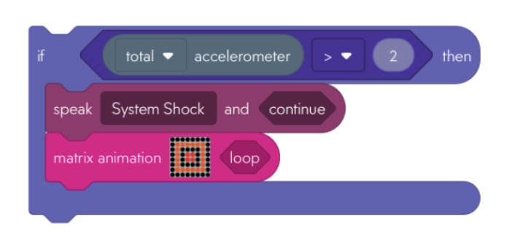
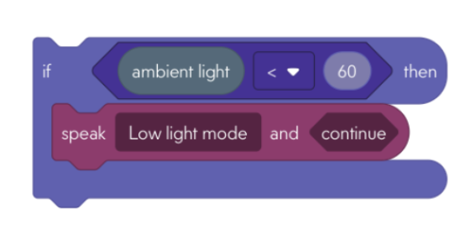
Try out some of these if blocks with the different events - What system could you come up with?
Notes:
Each individual code block shown will work perfectly on its own. However, if you want to combine multiple conditions together (like checking both light AND motion at the same time), you'll need to use "if/else" statements instead of separate "if" blocks. This prevents the device from getting confused and trying to do multiple things at once, and helps it run more efficiently.

Slide 9
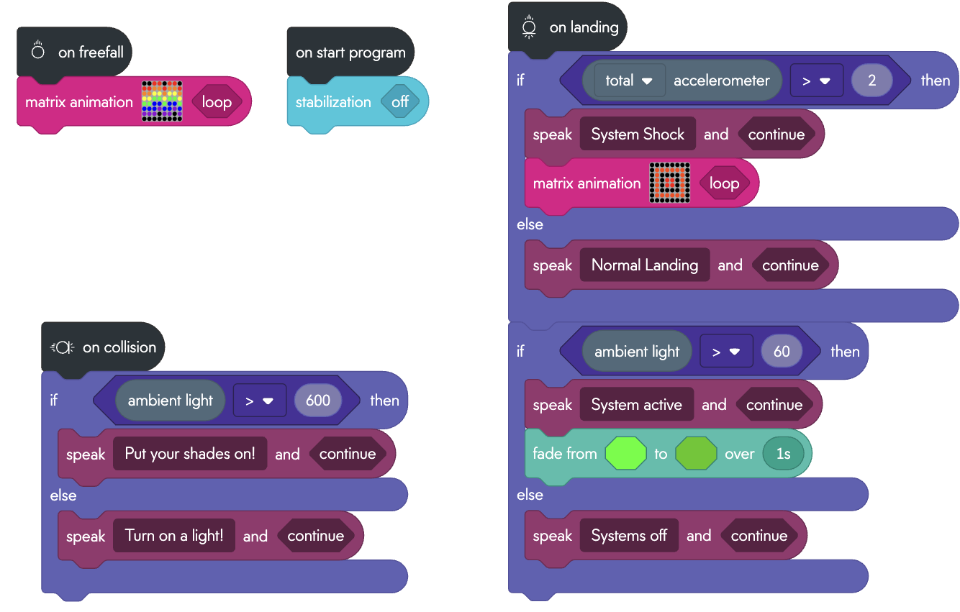
Possible Solution
Notes:
FYI stand directly under Halogen/roof light will spike the light sensor - See what happens when you put in a forever loop - standing under the light and away from the light
This solution uses if/else rather than 2 If Statements - more efficient than use just ‘if statements’
Think of it like this: if you only use "if" statements, it's like asking "Is it sunny?" and "Is it rainy?" even when you can already see it's sunny outside. Your device wastes time checking everything instead of stopping when it finds the answer.
Also, sometimes your device might get confused and try to do two things at once - like saying both "Normal Landing" AND "System Shock" at the same time, which sounds weird. Or it might not do anything at all if the number is exactly in the middle.
Using "if/else" is like giving your device smart choices - once it finds the right answer, it stops looking and does just one thing. This makes your device work faster and avoid getting confused.

Slide 10
PLENARY
Prove Your Event Mastery!
It's time to show off what you've learned about event-driven programming!
Assessment Questions:
How do events make programs more interactive?
What's the main advantage of event-driven programming?
Name three real-life devices that use event responses.
Prove It Task - Choose One:
Demonstrate: Show all your events and explain what triggers each one.
Design: Create a new event response for a different, unique situation.
Test: Test someone else's program and identify which events they used.
Explain: Describe how event programming could solve a real-world problem.

